Slide 1
Docker Essentials
Advanced Docker Concepts
8 May 2024, Speaker name

Slide 2
Agenda
1
Docker Volumes and Persistent Data
2
Docker Networking Essentials
3
Docker Compose: Multi-Container Applications
4
Docker Hub and Private Repositories
5
Best Practices for Docker Image Optimization
6
Debugging, Logging and Security

Slide 3
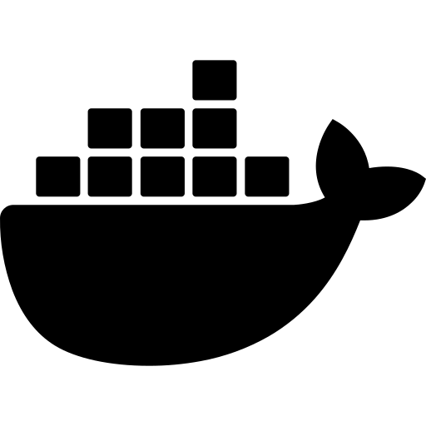

Why Persistent Data Matters
Docker container is ephemeral
Problem for stateful applications like
databases, logs, or user-uploaded files
Notes:
By default, data written inside a Docker container is ephemeral — it disappears when the container stops or is removed.
This becomes a problem for stateful applications like databases, logs, or user-uploaded files.

Slide 4



What Are Docker Volumes?
Volumes are Docker-managed directories
They persist data
Docker handles volume lifecycle

Slide 5



Why Use Volumes?
Data Persistence across container restarts
Decouples data from the container image
Improved performance compared to bind mounts in some cases
Easier backup and migration

Slide 6
Basic Volume Commands
1
# Create a named volume
docker volume create myvolume
2
# Run a container and attach the volume
docker run -d -v myvolume:/data nginx
3
# List all volumes
docker volume ls
4
# Inspect a volume
docker volume inspect myvolume

Slide 7



Docker Networking Essentials
With each other
(e.g., app ↔ database)
With the host
With external networks

Slide 8
Docker Network Drivers
Docker provides several network drivers, each with specific use cases
Driver | Use Case
bridge | Default for standalone containers on a single host
host | Uses host’s network stack (Linux only)
overlay | Multi-host networking (Docker Swarm)
none | No network; container is completely isolated

Slide 9
Basic Networking Commands
1
# List networks
docker network ls
2
# Create a custom bridge network
docker network create mynet
3
# Run a container on a specific network
docker run --network=mynet nginx

Slide 10
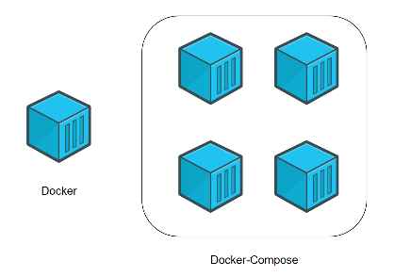


Docker Compose: Multi-Container Applications
Define and run multi-container Docker applications
Simplify startup using one configuration file
Easily manage linked services
(e.g., web server + database)

Slide 11


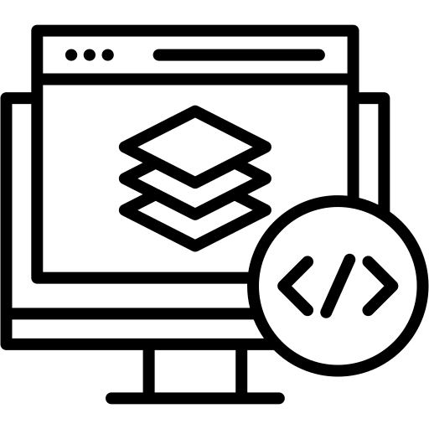
How It Works Together
Docker Compose automatically creates a network
Containers can talk to each other using service names
Makes setting up full development environments easy

Slide 12




What is docker-compose.yml? A YAML configuration file that defines
Services (containers to run)
Images and build instructions
Networking between containers
Volumes and environment variables

Slide 13
Basic docker-compose.yml Example
Specifies the version of Docker Compose syntax being used
version: "3"
services:
web:
image: nginx
ports:
- "80:80"
db:
image: mysql
environment:
MYSQL_ROOT_PASSWORD: secret
The name of the service (container). Can be used as a hostname within the network
Uses the official NGINX image from Docker Hub.
Maps port 80 of the container to port 80 of the host machine
The name of the database service (another container).
Sets environment variables for the container
Uses the official MySQL image from Docker Hub.
This is required by the MySQL image to set the root password.

Slide 14
Common Commands – Docker Compose
1
# Start all defined services
docker-compose up
2
# Start in detached (background) mode
docker-compose up -d
3
# Stop and remove services
docker-compose down
4
# View logs
docker-compose logs
5
# Rebuild images
docker-compose build

Slide 15
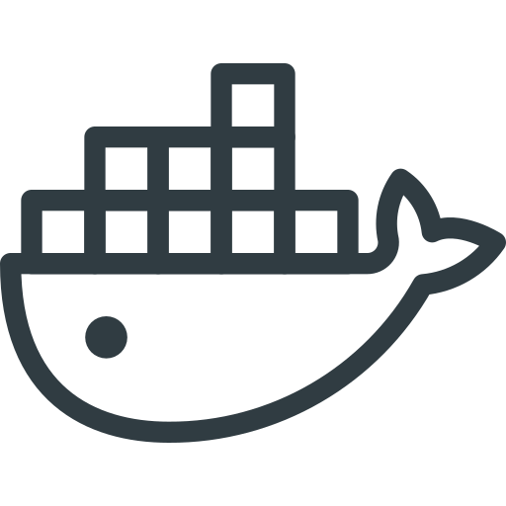


What is Docker Hub?
Docker images are stored, shared, and distributed
Users can push/pull images
Supports both public and private repositories

Slide 16
Working with Docker Hub
1
2
Pull an image from Docker Hub
Push your custom image
docker pull nginx
docker tag myapp username/myapp
docker push username/myapp

Slide 17


Private Repositories - Why use them?
Store sensitive/proprietary images
Control access (teams, CI/CD workflows)

Slide 18



Why Optimize Docker Images?
Reduces image size → faster builds, pushes, and pulls
Improves security by minimizing attack surface
Enhances performance and portability

Slide 19

Use .dockerignore
.dockerignore
Works like .gitignore
Prevents unnecessary files
(e.g., .git, node_modules, tests) from being
copied into the image

Slide 20
Summary of Best Practices
Practice | Benefit
Minimal base images | Smaller size, fewer CVEs
Clean temp files | Reduces image layers
Combine RUN commands | Optimized layering
Use .dockerignore | Faster build, fewer files
Multi-stage builds | Clean and production-ready

Slide 21



Debugging and Logging in Docker
Containers are often treated as black boxes
Without visibility, it's hard to know why something fails
Debugging and logging help ensure faster issue resolution and better reliability

Slide 22



Why Security Considerations in Docker
Host access
Data leaks
Vulnerabilities in production
Notes:
While Docker provides isolation, containers still share the host kernel. A misconfigured container can lead to:
Host access
Data leaks
Vulnerabilities in production

Slide 23



Use Trusted Base Images
Always use official or verified images
Avoid pulling images from unknown sources.
Reduces risk of malicious code or outdated packages.

Slide 24
Best Practices Summary
Practice | Why it Matters
Use trusted base images | Avoid malware and outdated libraries
Drop root privileges | Reduces potential damage
Store secrets securely | Protect sensitive data
Drop Linux capabilities | Enforce least privilege principle
Regular image scanning | Catch known vulnerabilities early
Limit network exposure | Reduce attack surface

Slide 25
Thank you

